Slide 1
MedTrack-DV
Hospital Operations & Patient Analytics Dashboard
Clinical Business Intelligence & Capacity Planning
HEALTHCARE BI AND CLINICAL OPERATIONS
Infosys Springboard Internship Project
Presented by: Iqlas Tharannum
Track: Data Visualization & Business Intelligence

Slide 2
AGENDA
01 | Clinical Problem & Project Objectives
Operational bottlenecks, data silos & project scope
02 | Data Pipeline & KPI Engineering Architecture
Data auditing, cleaning & 6 healthcare operational KPIs
03 | 4-Page Tableau Dashboard Suite & What-If Simulator
Throughput tracking, capacity alerts & surge modeling
04 | Technical Challenges, Key Learnings & Future Scope
Obstacles solved, key takeaways & predictive ML roadmap

Slide 3
PROBLEM STATEMENT
01 | Data Silos & Fragmentation
45,000 raw EHR records isolated across systems without unified operational visibility
02 | Retrospective Reporting Lag
Static tracking causes delayed bed allocations and clinical workflow bottlenecks
03 | Unmonitored Readmission Risks
Post-discharge return spikes lack systematic tracking against clinical benchmarks
04 | Lack of Surge Simulation
No real-time modeling tools to anticipate ICU and general bed capacity overflows.

Slide 4
PROJECT OBJECTIVES & MEASURABLE
IMPACT
PROJECT OBJECTIVES
Consolidate Siloed Clinical Data : Unify and clean 45,000+ patient records into an integrated data model for full operational visibility.
Eliminate Reporting Lags : Replace static, retrospective tracking with interactive throughput dashboards for daily operational decisions.
Benchmark Core Clinical Metrics : Establish dynamic monitoring for 30-day readmissions, ALOS, and departmental bed turnover rates
TARGET OUTCOMES & IMPACT
Proactive Capacity Allocation : Provide floor supervisors with occupancy alerts to prevent bottlenecks across acute care wards.
Readmission Risk Identification : Pinpoint high-risk diagnosis categories and age cohorts driving avoidable patient readmissions.
Interactive Surge Modeling : Equip leadership with what-if parametric controls to test and plan for surge scenarios.

Slide 5
DATA PIPELINE & ARCHITECTURE
01 | Raw Ingestion
• Source: 45,000+ Electronic Health Records (EHR).
• Ingestion: Demographics, admission & discharge timestamps, ward IDs, and clinical diagnosis codes.
03 | KPI Logic
• Calculations: Engineered ALOS, 30-Day Readmission flags, & Ward Occupancy %.
• Tableau Logic: Built custom Level of Detail (LOD) and conditional formulas.
02 | Data Cleansing
• Auditing: Imputed missing timestamps & filtered discharge date anomalies.
• Quality: Standardized clinical categories & validated length-of-stay durations.
04 | Semantic Layer
• Data Engine: Optimized Tableau Data Extracts (.hyper) for low-latency queries.
• Output: Clean unified data model powering the 4-page dashboard suite.

Slide 6
Tools & Tech Stack
ETL & Cleansing: Python (Pandas) / SQL / Power Query
Data Engine: Tableau Data Extract (.hyper)
Visualization: Tableau Desktop (LOD Expressions & Parameters)

Slide 7
CORE CLINICAL & OPERATIONAL KPIS
ENGINEERED
01 | Average Length of Stay (ALOS) Tracks patient stay duration across departments to identify bed retention delays.
02 | 30-Day Readmission Rate (%)
Flags unplanned returns within 30 days of discharge by diagnosis and demographic cohort.
03 | Bed Occupancy Rate (BOR %)
Real-time ward capacity tracking to prevent acute care overflow bottlenecks.
04 | Bed Turnover Rate (BTR)
Measures how frequently beds are vacated and sanitized for newly admitted patients.
05 | Emergency Admission Wait Time Quantifies duration from triage assessment to actual in-ward bed assignment.
06 | Surge Capacity & Stress Index Parametric threshold monitoring to trigger diversion protocols during sudden inflow spikes.

Slide 8
4-PAGE TABLEAU DASHBOARD SUITE
01 | Executive Operations Overview High-level KPI scorecard, total active census, and dynamic ward occupancy heatmaps.
02 | Patient Flow & Throughput Tracker Departmental transition times, triage-to-bed wait metrics, and ALOS trend analysis.
03 | Clinical Risk & Readmission Monitor
30-day readmission rate tracking, high-risk diagnosis categories, and cohort filtering.
04 | What-If Surge & Capacity Simulator Parametric scenario sliders to forecast ICU and general bed overflow thresholds.

Slide 9
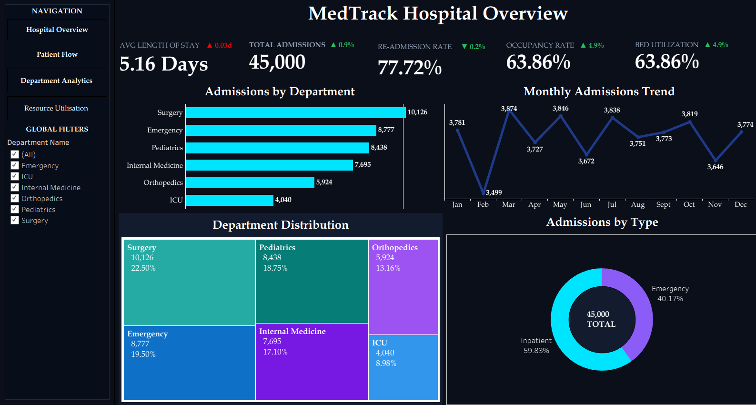
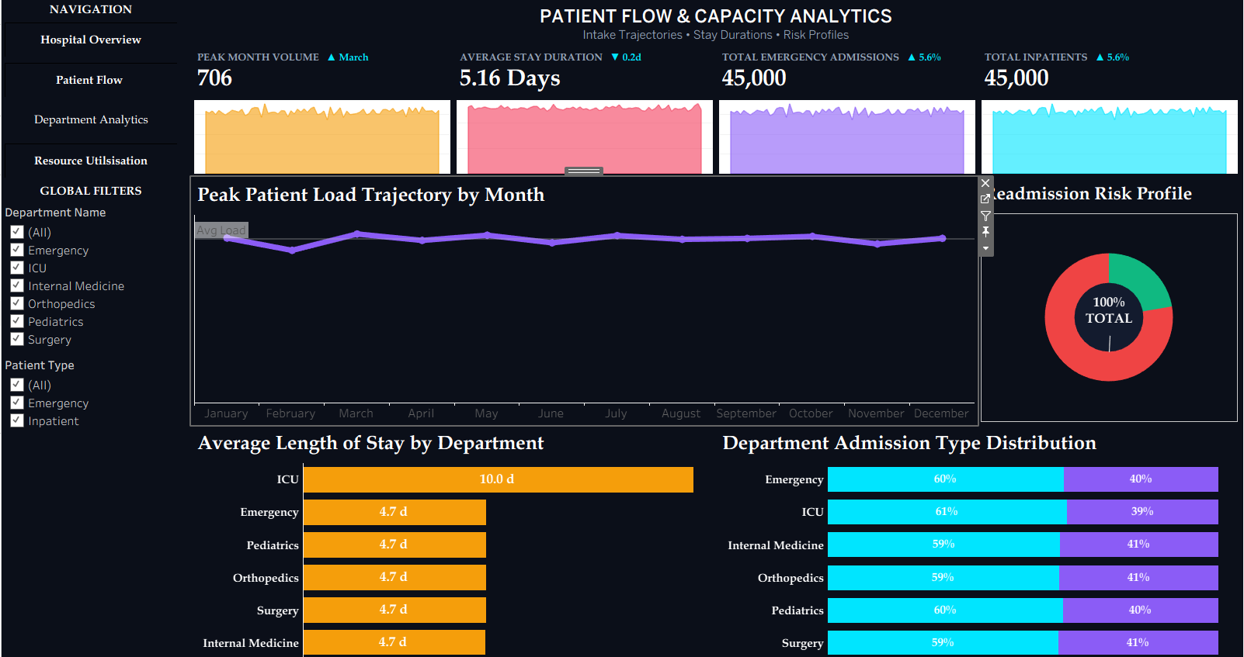
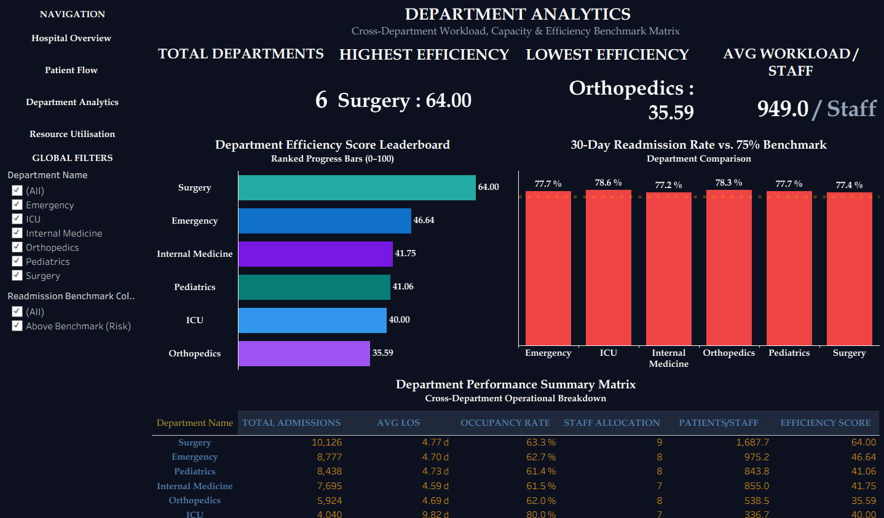
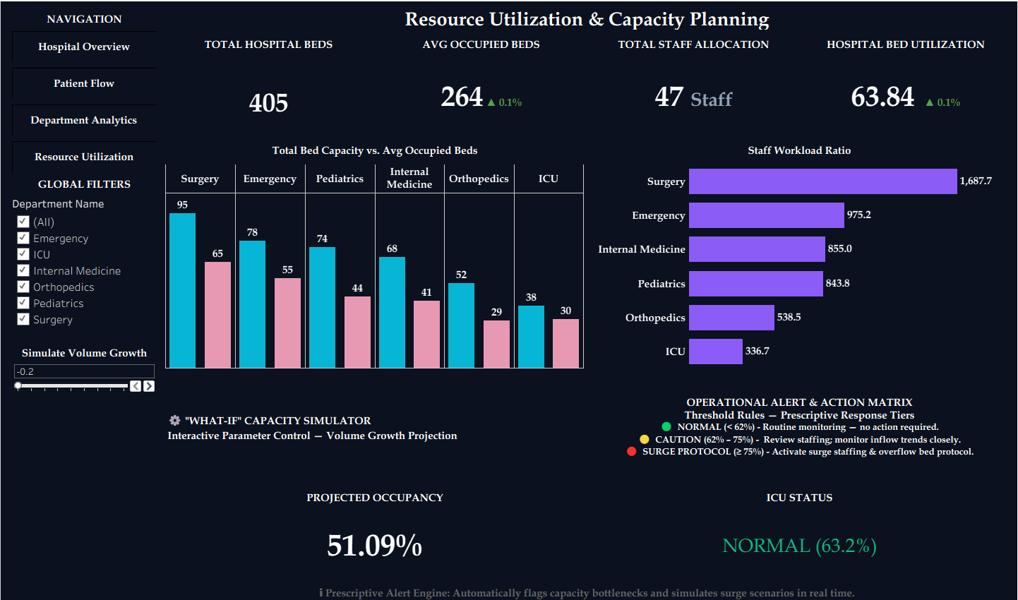
SCREENSHOTS

Slide 10
WHAT-IF SURGE SIMULATOR & DECISION LOGIC
01 | Parametric Input Controls
• Surge Multipliers: Interactive sliders to simulate 10%–50% emergency patient spikes.
• ALOS Variance: Dynamic toggles adjusting average stay duration by ward.
• Baseline Capacity: User-defined fixed bed ceilings across ICU and acute wards.
03 | Actionable Clinical Outcomes
• Diversion Protocols: Early warning flags to redirect non-critical inbound patients.
• Staff Reallocation: Data-driven shift scaling ahead of anticipated bottleneck spikes.
• Elective Rescheduling: Timely deferral of elective admissions during peak stress periods.
02 | Dynamic Modelling Logic
• LOD Calculations: Real-time formulas dynamically aggregating ward-level demand.
• Stress Indexing: Automated ratios calculating projected vs. available capacity.
• Threshold Triggers: Color-coded KPI alerts when occupancy exceeds 85% safety limits.

Slide 11
TECHNICAL CHALLENGES & KEY SOLUTIONS
01 | LOD Calculation Overhead
• Challenge: Complex Level of Detail (LOD) formulas across 45,000+ records caused dashboard latency and slow filter rendering.
• Solution: Pre-aggregated metrics into optimized .hyper extracts and restructured FIXED LOD expressions for sub-second query performance.
03 | Multi-Parameter Surge Modeling
• Challenge: Synchronizing dynamic bed demand across multiple independent wards without hardcoded capacity constraints.
• Solution: Built decoupled parameter controls and dynamic threshold formulas to calculate stress indices across wards in real time.
02 | Timestamp Inconsistencies
• Challenge: Raw EHR records contained irregular triage-to-admission timestamps, negative stay intervals, and missing discharge flags.
• Solution: Engineered automated data-cleansing rules in the ETL pipeline to filter anomalies and standardize duration logic.

Slide 12
KEY LEARNINGS & FUTURE ROADMAP
KEY TECHNICAL & ANALYTICAL LEARNINGS
• Optimized Data Architectures: Mastered Level of Detail (LOD) tuning and .hyper extraction techniques to handle 45,000+ records with sub-second latency.
• Translating Clinical Needs to Analytics: Learned to translate complex hospital operational KPIs (ALOS, 30-day readmissions) into actionable visual interfaces.
• Executive Dashboard UX: Applied visual hierarchy and interactive parameter modeling to deliver insights for both floor nurses and hospital leadership.
FUTURE ENHANCEMENTS & ROADMAP
• Predictive ML Integration: Embed machine learning classification models (e.g., Random Forest/XGBoost) for real-time patient readmission risk scoring.
• Automated Notification Engine: Implement automated email/webhook alerts triggered when ward occupancy crosses the 85% critical threshold.
• Multi-Hospital Network Scaling: Expand data pipelines to support multi-site EHR integration for cross-facility bed load balancing.

Slide 13
Thank You
Open for Questions & Feedback
Iqlas Tharannum
Data Visualization & Business Intelligence
Project: MedTrack-DV

